Slide 1
CS310 Operating Systems Lecture 0: Operating System - Course Introduction
Ravi Mittal
IIT Goa

Slide 2
What is so interesting about OS course?
Knowledge of OS and Computer Architecture gives you almost complete picture of ”how computers work?”
Operating System is evolving as processor architecture is evolving!
You will frequently use OS concepts in any area of your work
It will help you in getting a job in any company in the domain of Architecture, System, Networking, Internet, Embedded Systems and many more..

Slide 3
What is so interesting about OS course?
Some of you may actually design OS features, in future
Many of you will create systems that utilize the core concepts in operating systems.
Whether you build software or hardware
The concepts and design patterns appear at many levels
All of you will build applications, etc. that utilize operating systems
The better you understand their design and implementation, the better use you’ll make of them.
Most of applications in future will demand exploitation of parallelism available in the hardware
Multithreaded programming
In this course you will learn about Multithreading

Slide 4


Classes : Logistics
Zoom
You will learn only if you are attentive in the class
It’s up to you ..
Assignments: Many
Need to bring back personal interaction – even if it is virtual
Humans not good at interacting text-only
Hello!
Hi!

Slide 5

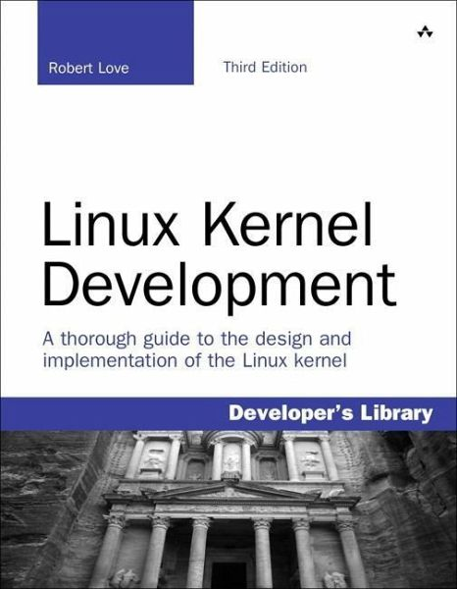
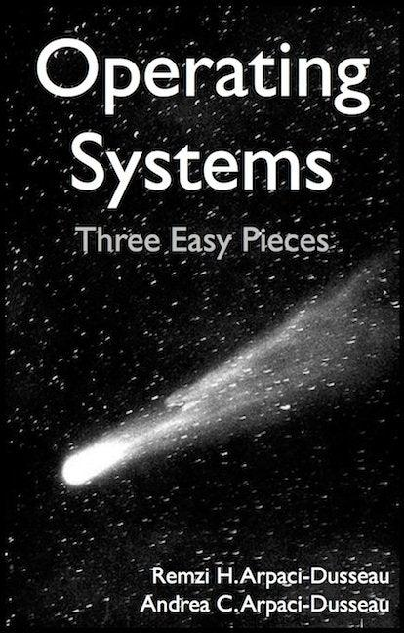
Infrastructure, Textbook & Readings
Infrastructure
Google Classroom
Gradescope
Textbook: Operating Systems: Principles and Practice (2nd Edition) Anderson and Dahlin
Supplementary Material
Operating Systems: Three Easy Pieces, by Remzi and Andrea Arpaci-Dusseau, available for free online
https://pages.cs.wisc.edu/~remzi/OSTEP/#instructors
Linux Kernel Development, 3rd edition, by Robert Love

Slide 6
Infrastructure, Textbook & Readings
Supplementary Material: Books
Operating System Concepts, 10th Edition, Avi Silberschatz, Peter Galvin, and Gred Gagne, John Wiley & Sons
Modern Operating System, William Stallings
An Introduction to Operating Systems: Concepts and Practice (GNU/Linux), PHI, Pramod C P Bhatt

Slide 7
Online video resources and course websites of Operating System course
CS162, Operating Systems and Systems Programming, University of California Berkeley, https://inst.eecs.berkeley.edu/~cs162/sp21/
https://youtu.be/itfEcA3TXq4

Slide 8
Syllabus
OS Concepts: How to Navigate as a Systems Programmer!
Process, I/O, Networks and Virtual Machines
Concurrency
Threads, scheduling, locks, deadlock, scalability, fairness
Address Space
Virtual memory, address translation, protection, sharing
Cache Memory (already covered in Computer Architecture Course)
Virtual Memory (already covered in Computer Architecture Course)
IPC Methods
Process Synchronization
File Systems
I/O devices, file objects, storage, naming, caching, performance, paging, transactions, databases
Security Concepts
Cloud and Data Centers

Slide 9
Better learn by yourself if you don’t know..
Proficiency in C
Pointers
Function Pointers
Memory Management (malloc, free, stack vs heap)

Slide 10
What additional stuff you can expect
A lot more programming assignments
No spoon feeding – google it – read books - do programming by yourself
You are now in the 3rd year.. Don’t expect hand holding
No class in case less than 90% students available
So learn it by yourself
How to handle monotony ?
You need to be alive in the class
Don’t take classes while watching matches …
Learn by sincere effort
No free lunches… need to earn your grade by working hard
Your learning matters to me … nothing else .. So please don’t try usual tricks..

Slide 12
Computing world is changing very fast!

Slide 13
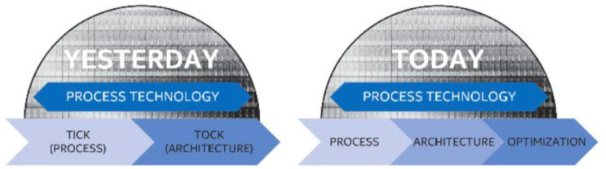
But then Moore’s Law Ended…
Moore’s Law has (officially) ended -- Feb 2016
No longer getting 2 x transistors/chip every 18 months…
or even every 24 months
May have only 2-3 smallest geometry fabrication plants left:
Intel and Samsung and/or TSMC
Vendors moving to 3D stacked chips
More layers in old geometries

Slide 14
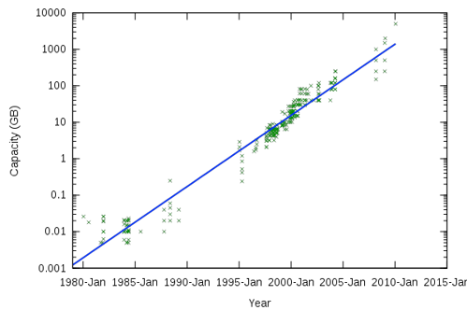
Storage Capacity is Still Growing!

Slide 15
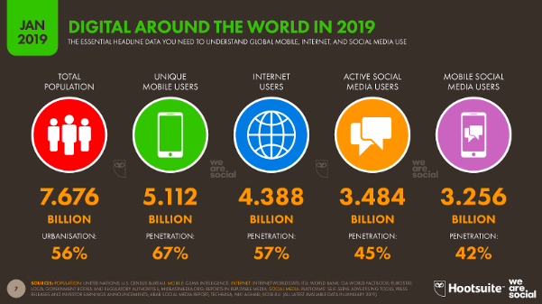
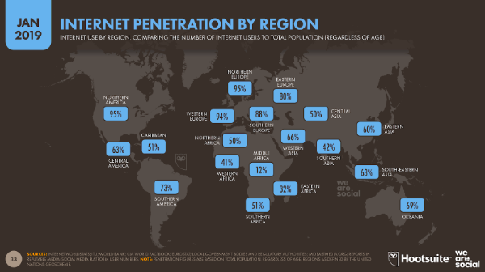
Society is Increasingly Connected…

Slide 16
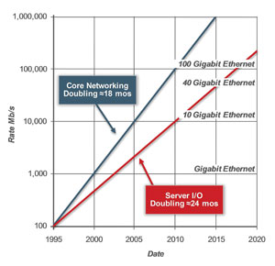
Network Capacity Still Increasing
(source: http://www.ospmag.com/issue/article/Time-Is-Not-Always-On-Our-Side )
Notes:
Networking bandwidth is expected to also outpace the CPU power, so more bandwidth per core.

Slide 17
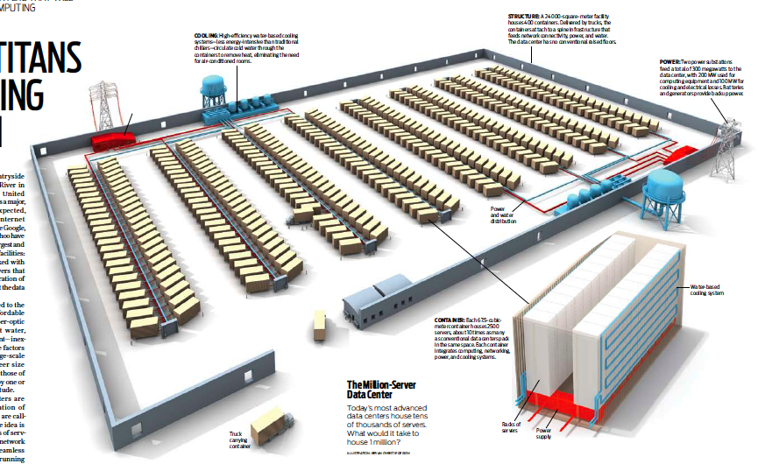
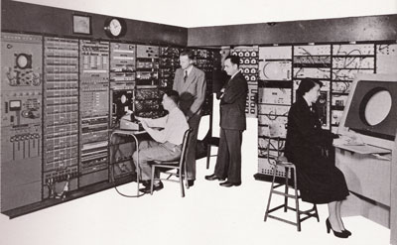
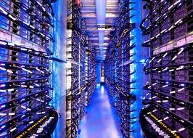
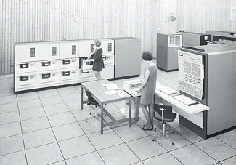
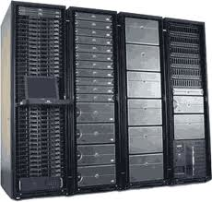
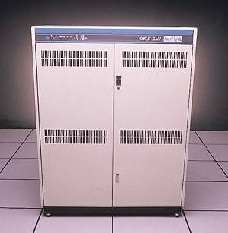
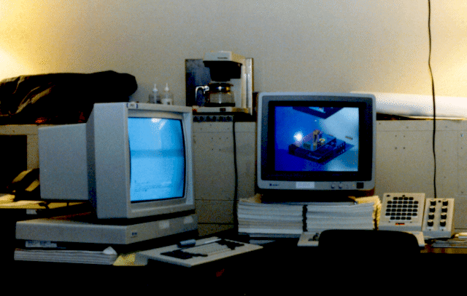
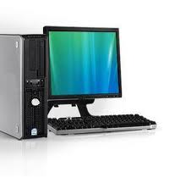
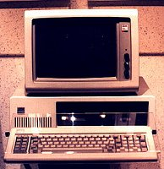
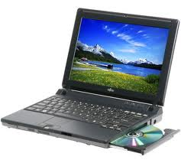


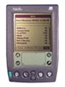


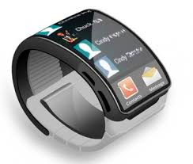

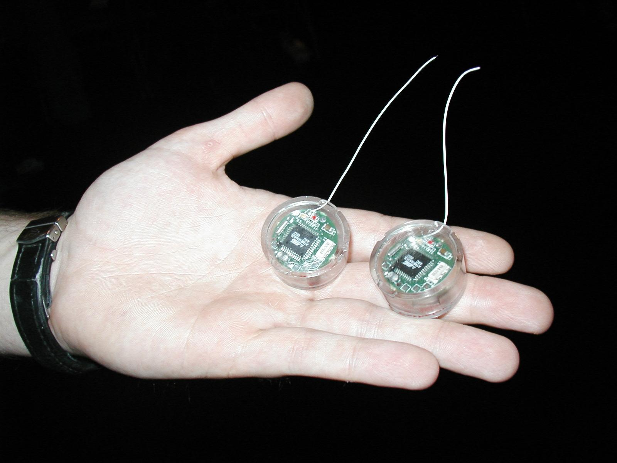

People-to-Computer Ratio Over Time
Computers
Per Person
Number crunching, Data Storage, Massive Inet Services,
ML, …
1:10⁶
Mainframe
Mini
1:10³
Workstation
Productivity,
Interactive
PC
1:1
Laptop
PDA
Cell
Streaming from/to the physical world
10³:1
years
Mote!
The Internet of Things!
Bell’s Law: new computer class per 10 years

Slide 18
Challenge: Complexity
Applications consisting of…
… a variety of software modules that …
… run on a variety of devices (machines) that
… implement different hardware architectures
… run competing applications
… fail in unexpected ways
… can be under a variety of attacks
Not feasible to test software for all possible environments and combinations of components and devices
The question is not whether there are bugs but how serious are the bugs!

Slide 19
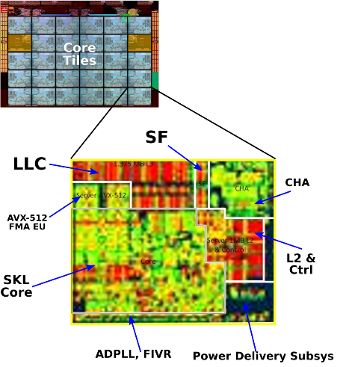
The World Is Parallel: Intel SkyLake (2017)
Up to 28 Cores, 56 Threads
694 mm² die size (estimated)
Many different instructions
Security, Graphics
Caches on chip:
L2: 28 MiB
Shared L3: 38.5 MiB (non-inclusive)
Directory-based cache coherence
Network:
On-chip Mesh Interconnect
Fast off-chip network directly supports 8-chips connected
DRAM/chips
Up to 1.5 TiB
DDR4 memory

Slide 20
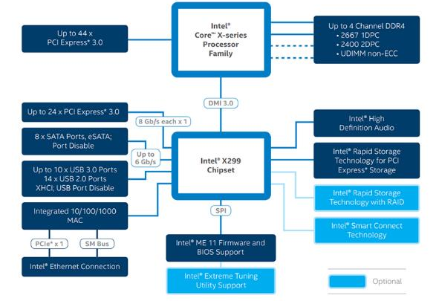
HW Functionality comes with great complexity!
Intel Skylake-X
I/O Configuration
Proc
Caches
Busses
adapters
Memory
Controllers
I/O Devices:
Disks
Displays
Keyboards
Networks

Slide 21
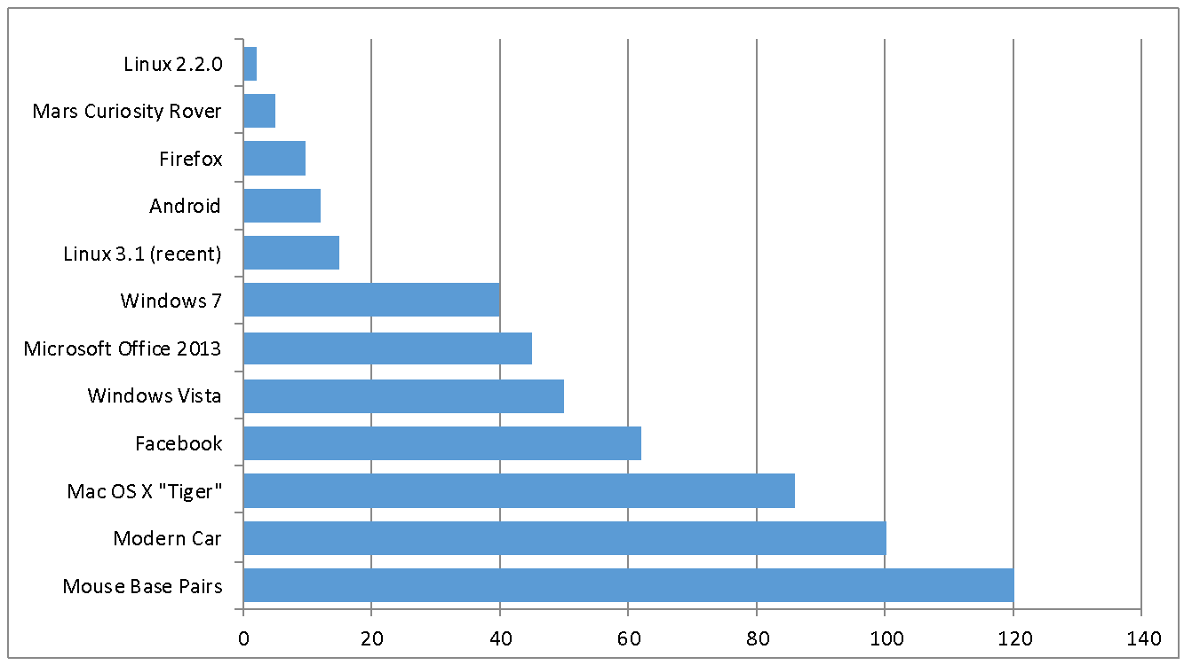
Increasing Software Complexity
Millions of Lines of Code
(source https://informationisbeautiful.net/visualizations/million-lines-of-code/)

Slide 22
Questions
Does the programmer need to write a single program that performs many independent activities?
Does every program have to be altered for every piece of hardware?
Does a faulty program crash everything?
Does every program have access to all hardware?
No, no!
Operating Systems help the programmer write robust programs!
It hides complexity of the system and presents an abstract view

Slide 23
Enjoy Learning CS310
It’s going to be exciting course
If you wish to learn …
Focus on what you are getting... Not on what you are not getting!
If you have doubts, just ask
Rather than grumbling and complaining
Be positive ..be honest …

